Slide 1
Smart Public Rest Rooms
Introduction
Sensor-based fixtures:
Smart restrooms often use sensors for hands-free operation of faucets, soap dispensers, flush toilets, and hand dryers, reducing the need for physical contact and minimizing the spread of germs.
These restrooms are equipped with sensors that continuously monitor restroom conditions, such as occupancy, temperature, and air quality. This data allows for better management and maintenance.
Sensors can detect issues like toilet paper or soap shortages and send alerts to maintenance staff, ensuring that supplies are replenished promptly.

Slide 2
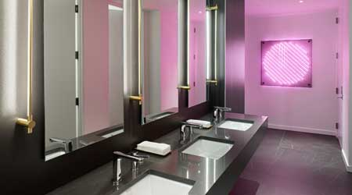
Real-time monitoring:
These restrooms are equipped with sensors that continuously monitor restroom conditions, such as occupancy, temperature, and air quality. This data allows for better management and maintenance.
Maintenance alerts:
Sensors can detect
issues like toilet paper or soap shortages and
send alerts to maintenance staff, ensuring
that supplies are replenished promptly

Slide 3
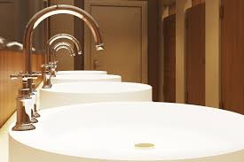
Energy efficiency:
Smart restrooms may employ energy-efficient lighting and ventilation systems to reduce energy consumption and environmental impact.
Accessibility features:
Many smart restrooms prioritize accessibility by including features like automated doors, larger stalls, and assistive devices for individuals with disabilities.

Slide 4
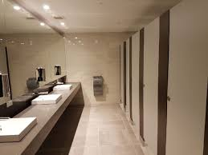
User feedback systems:
Some smart restrooms provide users with the opportunity to provide feedback or report issues through mobile apps or touchscreens, allowing for quick response to concerns.
Sustainability measures:
Smart restrooms often incorporate water-saving technologies like low-flow toilets and waterless urinals, contributing to water conservation efforts.

Slide 5
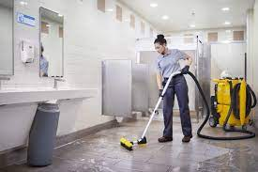
Security and access control:
These restrooms may employ secure access control systems, requiring keycards or codes for entry, enhancing safety and cleanliness.

Slide 6

Smart restrooms are technologically advanced restroom facilities that incorporate various features to enhance user experience, cleanliness, and operational efficiency. Some key aspects of smart restrooms include

Slide 7

conclusion
overall, smart restrooms aim to provide a more comfortable, hygienic, and efficient restroom experience while contributing to sustainability and public health efforts.

